Slide 1
Digital signal processing (EC 550) Noise removal in images
Name: Bhagyanidhi A Patil

Slide 2
What is Image noise?
Image noise is random variation of brightness or color information in images, and is usually an aspect of electronic noise. It can be produced by the image sensor and circuitry of a scanner or digital camera.
Noise is the result of errors in the image acquisition process that result in change in pixel values that do not reflect the true intensities of the real scene.

Slide 3
How to remove noise in an image?
Noise removal can be achieved, by using a number of existing filtering techniques.
Noise removal algorithm is the process of removing or reducing the noise from the image. The noise removal algorithms reduce or remove the visibility of noise by smoothing the entire image leaving areas near contrast boundaries.

Slide 4
Types of noise:
SALT NOISE
PEPPER NOISE
GUASSIAN NOISE

Slide 5
Salt and pepper noise
Salt-and-pepper noise is a form of noise sometimes seen on images. It is also known as impulse noise.
This noise can be caused by sharp and sudden disturbances in the image signal. It presents itself as sparsely occurring white and black pixels.
The effect is similar to sprinkling white and black dots—salt and pepper—on the image.

Slide 6
Gaussian noise
It is statistical noise having a probability density function (PDF) equal to that of the normal distribution, which is also known as the Gaussian distribution.
Principal sources of Gaussian noise in digital images arise during acquisition e.g. sensor noise caused by poor illumination and/or high temperature, and/or transmission e.g. electronic circuit noise.

Slide 7
Types of filter used to remove image noise
Mean filter
Median filter
Mid point filter

Slide 8
Block Diagram
INPUT IMAGE
NOISE ADDITION
FILTERING ALGORITHM
RESTORED IMAGE

Slide 9
Mean filter
Mean filters are used to remove salt pepper noise.
The mean filter is a simple sliding-window spatial filter that replaces the center value in the window with the average (mean) of all the pixel values in the window.
This has the effect of eliminating pixel values which are unrepresentative of their surroundings.
Mean filtering is usually thought of convolution filter .It is based on kernel which represents the shape and size of the neighborhood to be sampled when calculating the mean. Often 3x3 kernel is used.

Slide 10
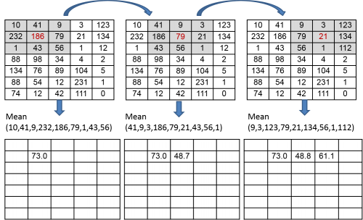

Slide 11
Median filter [average filter]
Median filter is used to remove salt pepper and noise .
A median filter is a nonlinear filter in which each output sample is computed as the median value of the input samples under the window .
The main idea of the median filter is to run through the signal entry by entry, replacing each entry with the median of neighboring entries.
The median is calculated by first sorting all the pixel values from the surrounding neighborhood into numerical order and then replacing the pixel being considered with the middle pixel value.

Slide 12
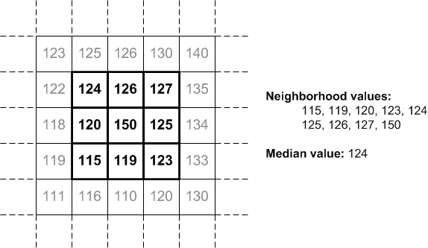

Slide 13
Mid point filter
The midpoint filter is typically used to filter images containing short tailed noise such as Gaussian and uniform type noises.
This function works only for monochrome,8bit per pixel and 24 bit per pixel images.
In the midpoint method, the color value of each pixel is replaced with the average of maximum and minimum (i.e. the midpoint) of color values of the pixels in a surrounding region.

Slide 14

where the coordinate (x+i, y+j ) is defined over the image and the coordinate (i, j) is defined over the N x N size square mask.

